Slide 1
Project Management
Project Life Cycle

Slide 2
Project Life Cycle
A project life cycle is the series of phases that a project passes through from its initiation to its closure. The
phases are generally sequential, and their names and numbers are determined by the management and control
needs of the organization or organizations involved in the project, the nature of the project itself, and its area of
application. The phases can be broken down by functional or partial objectives, intermediate results or deliverables,
specific milestones within the overall scope of work, or financial availability.

Slide 3
Characteristics of the Project Life Cycle
Starting the project,
• Organizing and preparing,
• Carrying out the project work, and
• Closing the project.

Slide 4
Predictive Life Cycles
Predictive life cycles (also known as fully plan-driven) are ones in which the project scope, and the time and cost required to deliver that scope, are determined as early in the project life cycle as practically possible.
Predictive life cycles are generally preferred when the product to be delivered is well understood, there is a substantial base of industry practice, or where a product is required to be delivered in full to have value to stakeholder groups.

Slide 5
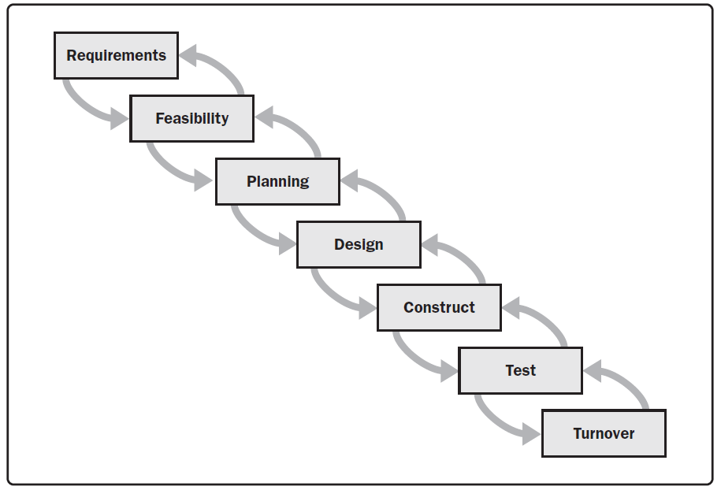

Slide 6
Iterative and Incremental Life Cycles
Iterative and incremental life cycles are ones in which project phases (also called iterations) intentionally repeat one or more project activities as the project team’s understanding of the product increases. Iterations develop the product through a series of repeated cycles, while increments successively add to the functionality of the product.
These life cycles develop the product both iteratively and incrementally.
In most iterative life cycles, a high-level vision will be developed for the overall undertaking, but the detailed scope is elaborated one iteration at a time.

Slide 7
Iterative and incremental life cycles are generally preferred when an organization needs to manage changing objectives and scope, to reduce the complexity of a project, or when the partial delivery of a product is beneficial and provides value for one or more stakeholder groups without impact to the final deliverable or set of deliverables.
Large and complex projects are frequently executed in an iterative fashion to reduce risk by allowing the team to incorporate feedback and lessons learned between iterations.

Slide 8
Adaptive Life Cycles
Adaptive life cycles (also known as change-driven or agile methods) are intended to respond to high levels of change and ongoing stakeholder involvement.
Adaptive methods are also iterative and incremental, but differ in that iterations are very rapid (usually with a duration of 2 to 4 weeks) and are fixed in time and cost. Adaptive projects generally perform several processes in each iteration, although early iterations may concentrate more on planning activities.

Slide 9
The overall scope of the project will be decomposed into a set of requirements and work to be performed, sometimes referred to as a product backlog.
The sponsor and customer representatives should be continuously engaged with the project to provide feedback on deliverables as they are created and to ensure that the product backlog reflects their current needs.
Adaptive methods are generally preferred when dealing with a rapidly changing environment, when requirements and scope are difficult to define in advance, and when it is possible to define small incremental improvements that will deliver value to stakeholders.

